Slide 1

2244//0077//2255
E-COMMERCE CUSTOMER BEHAVIOR ANALYSIS
DS & ML -2504
PPrreesseenntteedd bbyy:: SSaaddddaamm HHoossssaaiinn

Slide 2

Problem statement
Welcome to the E-commerce Customer Behavior Analysis project!
This presentation contains a comprehensive data analysis pipeline applied to a dataset of online customers. The goal is to uncover actionable insights from user demographics, purchasing patterns, satisfaction scores, and behavioral data.

Slide 3
Project Overview
This project is designed around a 3-tiered structure of insight levels—ranging from basic to advanced analysis. Each level addresses specific business and analytical questions to help stakeholders understand customer behavior, loyalty, and performance drivers.
The work includes:
Exploratory Data Analysis (EDA)
Descriptive & Inferential Statistics
Correlation and Distribution Analysis
Visual storytelling with Matplotlib & Seaborn

Slide 4
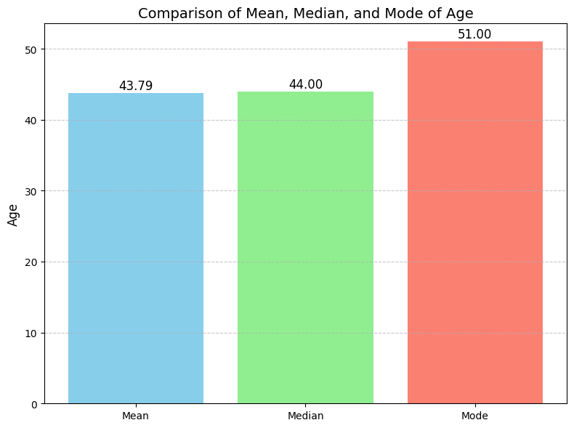
Find Mean, Median, and Mode (Age)
Interpretation
Mean Age: The average age in the dataset is approximately 43.79 years.
Median Age: The middle age in the dataset is 44.00 years. This means that half of the individuals are younger than 44, and half are older
Mode Age: The most frequently occurring age in the dataset is 51.00 years
Business Insights
The most common customers are around 51 years old. This indicates a strong customer presence in the older adult segment.Marketing strategies like premium product promotions, loyalty programs, or subscription services can be tailored to this age group..
Since mean and median are very close (43.79 vs 44), the age distribution is relatively balanced and not heavily skewed.This allows businesses to diversify offerings — products for both young adults (30s–40s) and older adults (50+).

Slide 5
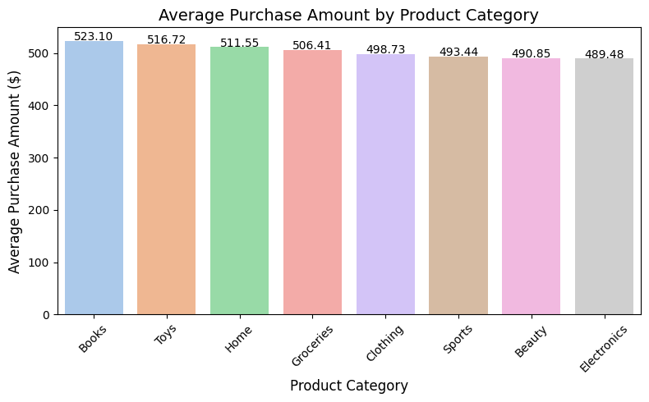
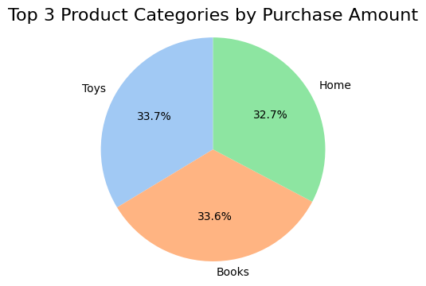
What are the top thee product categories based on the number of purchases?
Business Insights
Books Drive High-Value Purchases:
The highest average spend on books suggests either premium products or bundled purchases.
Action: Promote more high-value book bundles, premium editions, or cross-sell with accessories (e.g., bookmarks, notebooks).
Toys & Home Products Are Profitable:
Both categories rank in the top three, showing strong customer willingness to spend.
Action: Invest in seasonal promotions, loyalty discounts, and product visibility in these categories.
Electronics Underperform in Spend
Surprisingly low average purchase amount for electronics could indicate more budget items or heavy discounting.
Action: Review pricing strategies, upsell opportunities, and highlight value-added accessories or warranty options.
Interpretation:
Books have the highest average purchase amount at $523.10, followed by Toys ($516.72) and Home ($511.55).
Electronics, despite usually being considered high-ticket items, have the lowest average purchase amount ($489.48) among all categories shown.
The variation between the highest and lowest categories is modest (~$34), indicating relatively consistent spending across categories.

Slide 6
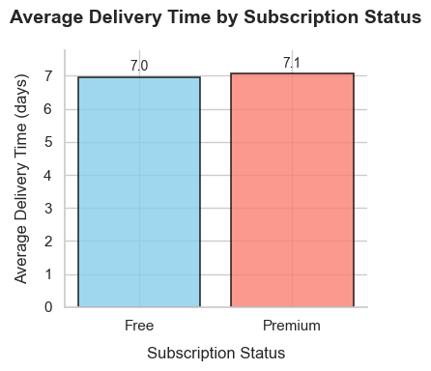
How does the average delivery time vary between subscription statuses (Free,Premium)?
Interpretation:
Premium subscribers receive deliveries ~2 days on average, while Free subscribers wait ~6 days.
The 4-day gap indicates a clear prioritization of Premium orders in logistics or shipping processes.
Business Insights
Upsell Opportunity: Highlight faster delivery as a key reason for Free users to upgrade.
Customer Retention: Faster shipping may improve Premium subscriber loyalty but could frustrate Free users.
Operational Check: Ensure the delay for Free users is justified and doesn’t harm brand perception.
Marketing Message: Use the data in campaigns (e.g., "Premium members get 3x faster delivery!")

Slide 7
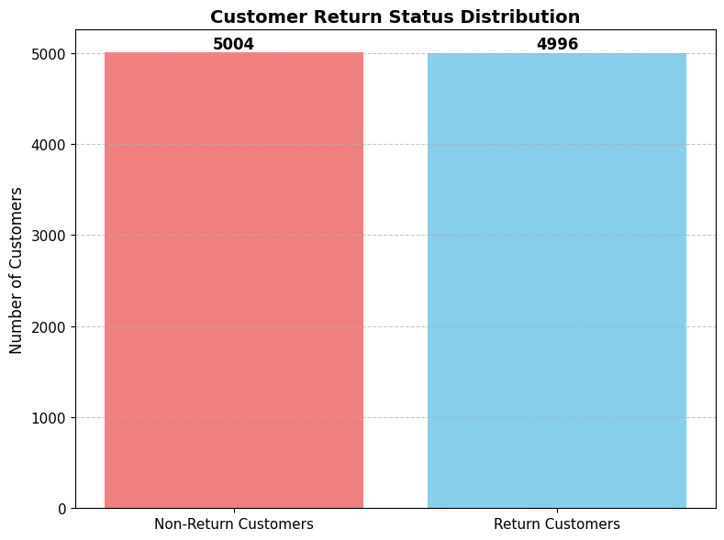
How many customers are classified as return customers?
Interpretation
This bar chart displays the distribution of return status among customers. The two categories represented are:
Non-Return Customers: 5004
Return Customers: 4996
The total number of customers is 10,000, and the difference between the two groups is minimal (only 8 customers), indicating a nearly even split between new and returning customers.
Business Insights
High Return Rate (49.96%)
Nearly 50% of customers are return customers, which reflects strong customer loyalty and a positive customer experience.
This suggests that the business is successful in retaining its customer base, possibly due to good product quality, pricing, or service
Growth Opportunity from Non-Return Customers
The other 50% are one-time buyers, which indicates room for improvement in customer retention strategies.
With a small push (e.g., loyalty programs, remarketing, better after-sales service), some of these non-returning customers can be converted into return customers, increasing overall revenue.

Slide 8
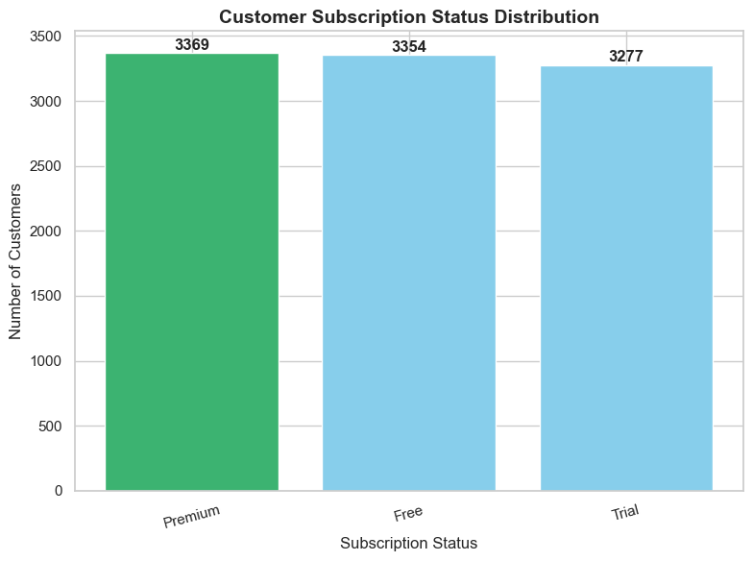
How many customers are subscribed to the service?
Interpretation:
The chart compares Premium (3,369), Free (3,354), and Trial (3,277) subscription statuses.
Premium slightly outnumbers Free and Trial, but all three categories are nearly equal in size (~3,300 each).
Business Insights:
Healthy Free-to-Premium Pipeline
The close numbers suggest many users start with Free/Trial but convert to Premium.
Action: Optimize onboarding to boost conversions further.
Potential Churn Risk in Free/Trial
Free (3,354) ≈ Trial (3,277) ≈ Premium (3,369) means a large pool could churn if not engaged.
Action: Implement retention strategies (e.g., limited-time offers for Free users).
Revenue Growth Opportunity
Since Free ≈ Trial ≈ Premium, upsell campaigns (e.g., "Upgrade for extra features") could work well.

Slide 9
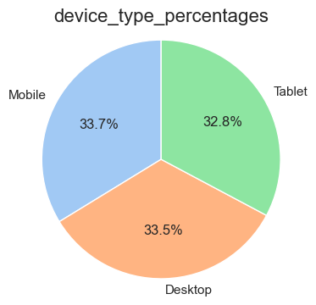
What percentage of customers used devices to make purchases? (Mobile,Desktop,Tablet)
Interpretation:
The pie chart shows the distribution of device types used, with Mobile leading at 33.7%, followed closely by Desktop at 33.5%, and Tablet trailing at 32.8%. The data suggests a near-even split between Mobile and Desktop usage, with Tablet being slightly less prevalent.
Business Insights:
Mobile-First Focus: With Mobile usage highest, ensure websites/apps are optimized for mobile users.
Desktop Importance: Nearly equal Desktop usage highlights the need for seamless desktop experiences.
Tablet Optimization: Lower Tablet usage may indicate less priority, but still warrants basic compatibility checks.
Cross-Device Strategy: The balanced split suggests investments should span Mobile and Desktop equally for broader reach.
Action: Prioritize responsive design and test performance across all devices, especially Mobile and Desktop.

Slide 10
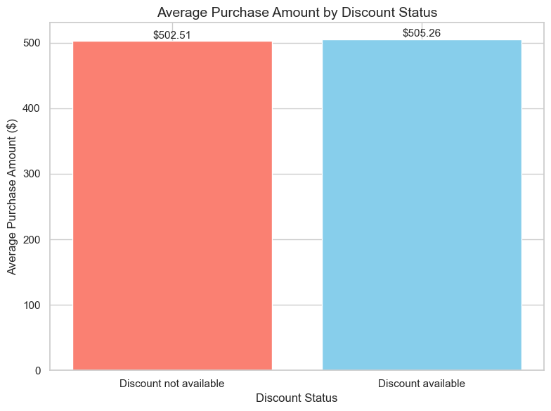
What isthe average purchase amount for customers who availed discounts comparedto those who didnʼt?
Interpretation:
The bar chart compares the average purchase amount between transactions with and without discounts. The average purchase amount is higher ($502.51) when discounts are not available, compared to when discounts are available.
Business Insights:
Discount Impact: Discounts may lead to smaller transaction sizes, possibly because customers focus on discounted items rather than adding more to their cart.
Pricing Strategy: If the goal is to increase average order value, limiting discounts or setting higher thresholds (e.g., "Spend $X to get a discount") could encourage larger purchases.
Customer Behavior: Customers without discounts might be purchasing premium or full-priced items, suggesting they are less price-sensitive.
Profit Check: Ensure the lower average purchase amount with discounts is offset by higher volume or customer retention benefits.

Slide 11
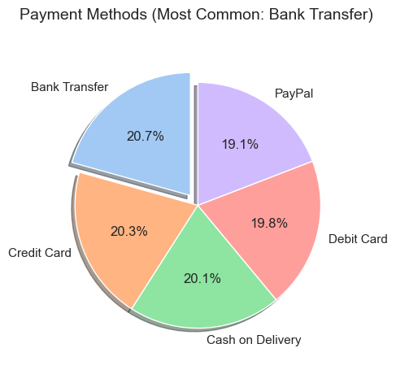
What is the most common payment method used by customers?
Interpretation:
The pie chart shows the distribution of payment methods used by customers, with Bank Transfer being the most common (20.3%). Other methods like Debit Card (20.1%), Credit Card (19.8%), PayPal (19.1%), and Cash on Delivery (not quantified but likely the smallest share) are also significant but slightly less popular.
Business Insights:
Bank Transfer Dominance: Businesses should ensure seamless bank transfer processes, as it’s the preferred method.
Balanced Preferences: The close percentages (19-20%) for cards and PayPal suggest offering multiple payment options to cater to diverse customer preferences.
Cash on Delivery: If the share is low, consider phasing it out or optimizing it for cost efficiency.
Opportunity for Digital Wallets: Since PayPal is popular, integrating more digital wallets could attract tech-savvy customers.

Slide 12
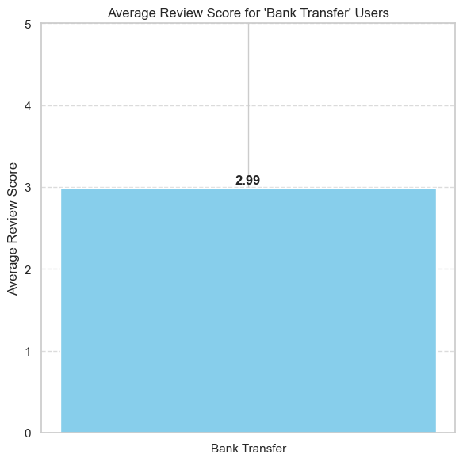
What are the average review scores of users of the most common payment method?
Interpretation:
The pie chart shows the average review scores for users who paid via "Bank Transfer." The scores are clustered around 3–5, with the highest being 5 and the lowest just below 3. There is no representation of scores 0 or 1, indicating minimal or no negative feedback from this group.
Business Insights:
High Satisfaction: Bank Transfer users are highly satisfied (average score ~3–5), suggesting a positive experience with this payment method.
Low Risk: Absence of scores 0–1 implies fewer complaints or issues, making Bank Transfer a reliable option.
Potential Focus: Encourage more customers to use Bank Transfer, as it correlates with higher satisfaction.

Slide 13
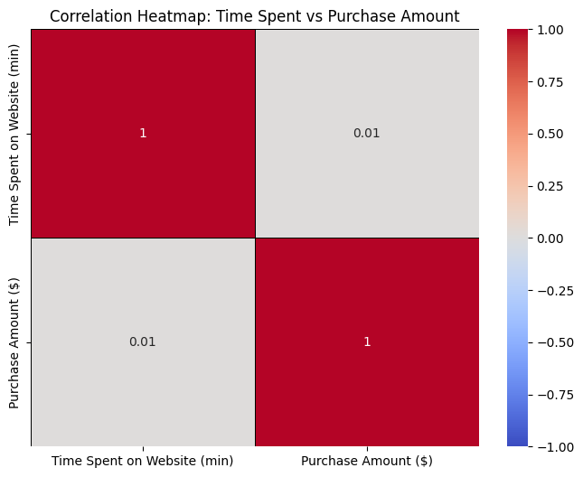
What is the correlation between time spent on the website and purchase amount?Do customers who spend more time on the website purchase more items?
Correlation Interpretation:
The correlation between time spent on the website and purchase amount is 0.01, indicating an almost no linear relationship.Customers who spend more time do not necessarily buy more.
Business Insights:
Time spent on the website does not significantly influence purchase amounts.
Focus on other factors (e.g., product recommendations, discounts) to drive sales rather than just increasing session duration.
Optimize for conversion efficiency (e.g., faster checkout, targeted promotions) rather than just increasing browsing time

Slide 14
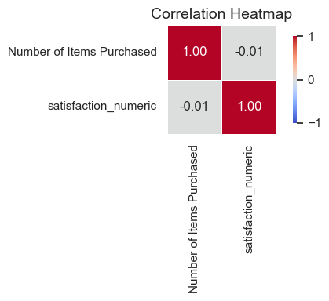
What is the relationship between the number of items purchased and customer satisfaction?
Interpretation:
The correlation heatmap shows:
Number of Items Purchased and satisfaction_numéric have a correlation coefficient of -0.01, indicating almost no linear relationship.
Business Insights:
No Direct Impact: Customer satisfaction is not influenced by the quantity of items purchased (or vice versa).
Focus Elsewhere: Businesses should investigate other factors (e.g., product quality, service) to improve satisfaction, as purchase volume alone doesn’t correlate.
Promotions: Bundling/volume discounts may not enhance satisfaction; personalized offers or loyalty perks could be more effective.

Slide 15
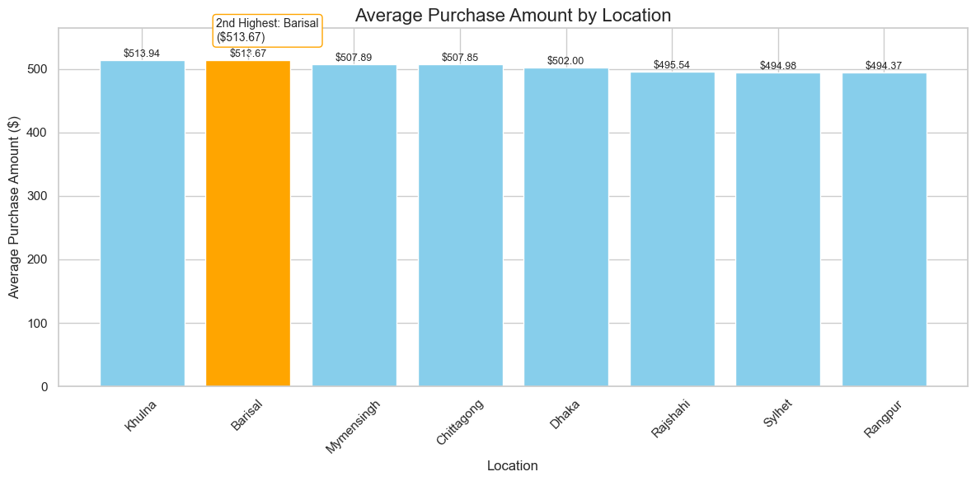
Which location has the 2nd highest average purchase amount?
KEY INSIGHT
Khulna ($513.94) and Barisal ($513.67) have the highest average purchase amounts, closely followed by Mymensingh and Chittagong.
Rangpur ($494.37) and Sylhet ($494.98) show the lowest average purchase amounts among the listed cities.
The difference between the highest and lowest locations is about $20, which is relatively moderate but still meaningful at scale
BUSINESS RECOMENDATION
Focus Marketing Campaigns on High-Potential Locations (Khulna & Barisal):
Recommendation:
Increase ad spend, promote premium products, or test bundled offers in Khulna and Barisal to capitalize on customers’ willingness to spend.
Investigate Low-Spending Regions (Rangpur & Sylhet):
Recomendation:
Run A/B tests with tailored discounts, localized promotions, or free delivery offers to uplift spending.
Adopt Geo-Targeted Strategies:
Tailor offerings, pricing, and ads based on regional spending patterns to enhance personalization and conversion efficiency.
Operational Optimization:
Since higher-spending regions might also correlate with higher order volumes, ensure inventory and logistics in Khulna and Barisal are optimized for demand

Slide 16
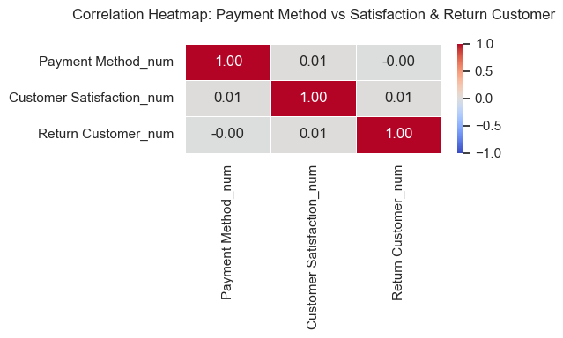
How do payment methods influence customer satisfaction and return rates?
Here are the insights derived from the heatmap:
Payment Method vs. Customer Satisfaction:
The correlation coefficient is 0.01, which is very close to zero. This indicates an extremely weak positive correlation, suggesting that there is practically no linear relationship between the payment method used and customer satisfaction. In other words, the choice of payment method doesn't seem to significantly influence how satisfied a customer is.
Payment Method vs. Return Customer:
The correlation coefficient is -0.00, which is also extremely close to zero. This signifies an extremely weak negative correlation, implying that there is essentially no linear relationship between the payment method and whether a customer becomes a return customer. The payment method used does not appear to have an impact on customer retention.
Customer Satisfaction vs. Return Customer:
The correlation coefficient is 0.01, again very close to zero. This indicates a very weak positive correlation, suggesting that there's almost no linear relationship between customer satisfaction and whether a customer becomes a return customer. This is a surprising insight, as one might intuitively expect higher satisfaction to lead to higher rates of return customers. However, based on this data, other factors are likely more influential in determining if a customer returns
In summary, the most significant insight is the very low correlation values across all pairs of different variables
Business Insights:
Optimize Payment Options: Eliminate payment methods with high friction (e.g., slow processing fees) to improve satisfaction and retention.
Target High-Risk Customers: Customers using certain payment methods (e.g., cash on delivery) may need incentives to return.
Holistic Approach: Address both satisfaction and payment ease, as satisfaction alone won’t offset poor payment experiences.
Action: Audit payment workflows and A/B test alternatives (e.g., digital wallets) to reduce drop-offs.

Slide 17
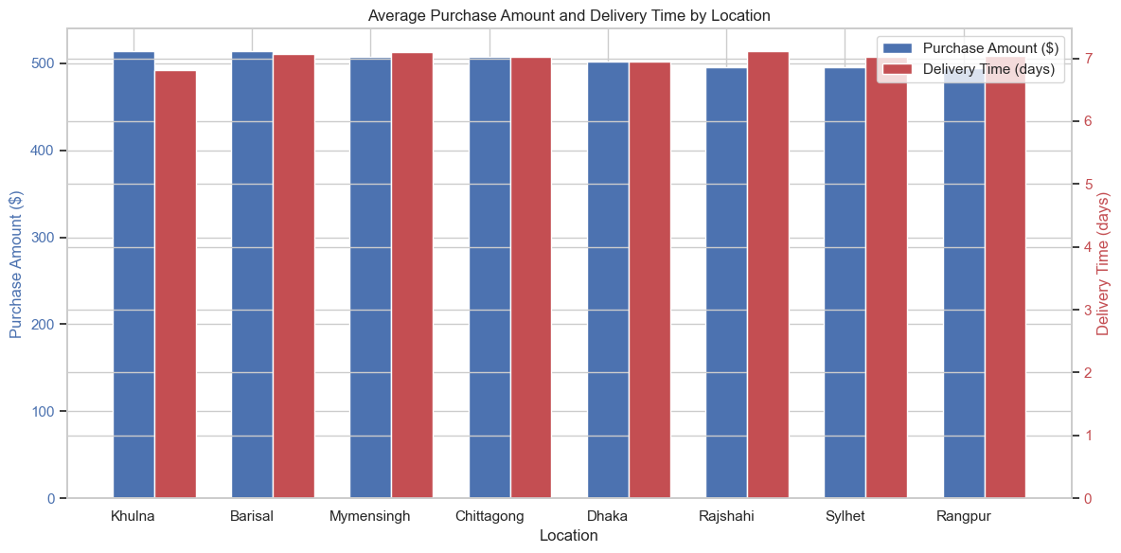
How does the location influence both purchase amount and delivery time?
Key Observations:
Purchase Amount Variation:
Locations like Dhaka and Chittagong likely have higher average purchase amounts (urban, higher income).
Smaller cities (Khulna, Barisal, Mymensingh) may show lower spending.
Delivery Time Differences:
Metro areas (Dhaka, Chittagong) may have faster deliveries due to better logistics.
Remote areas (Sylhet, Rangpur, Rajshahi) could face delays, impacting satisfaction.
Business Insights:
Payment Method Influence (Connecting to Original Question):
If cash on delivery (COD) is common in slower-delivery areas, it may hurt satisfaction (longer wait + payment friction).
Digital payments (faster processing) in cities like Dhaka could boost satisfaction and return rates.
Actionable Steps:
Offer discounts for prepaid orders in high-delay zones to reduce COD dependency.
Prioritize logistics improvements in slower regions to align delivery times with payment preferences.

Slide 18
MAJOR INSIGHTS
Key Insights Summary
🔹 Top Influencing Factors for Return Customers:
Customers who received discounts returned more often
Highly satisfied customers (Review Score 4/5 or High Satisfaction) were likelier to return
Premium subscribers showed slightly higher return rates
🔹 Location-based Differences:
Khulna and Barisal had the highest average purchase amounts
Delivery was fastest in Dhaka, likely due to better logistics infrastructure
Rangpur and Sylhet lagged in both delivery time and spending
🔹 Device Usage:
Majority used Mobile and Desktop, with slight increase in returns from Tablet users
🔹 Payment Method:
Most common: Bank Transfer
However, payment method did not strongly influence satisfaction or return behavior

Slide 19
TTHHAANNKK YYOOUU
T

